Slide 1
Ethics in Algorithmic Media
JOUR479V/779V – Computational Journalism
University of Maryland, College Park
Nick Diakopoulos, Ph.D.

Slide 2
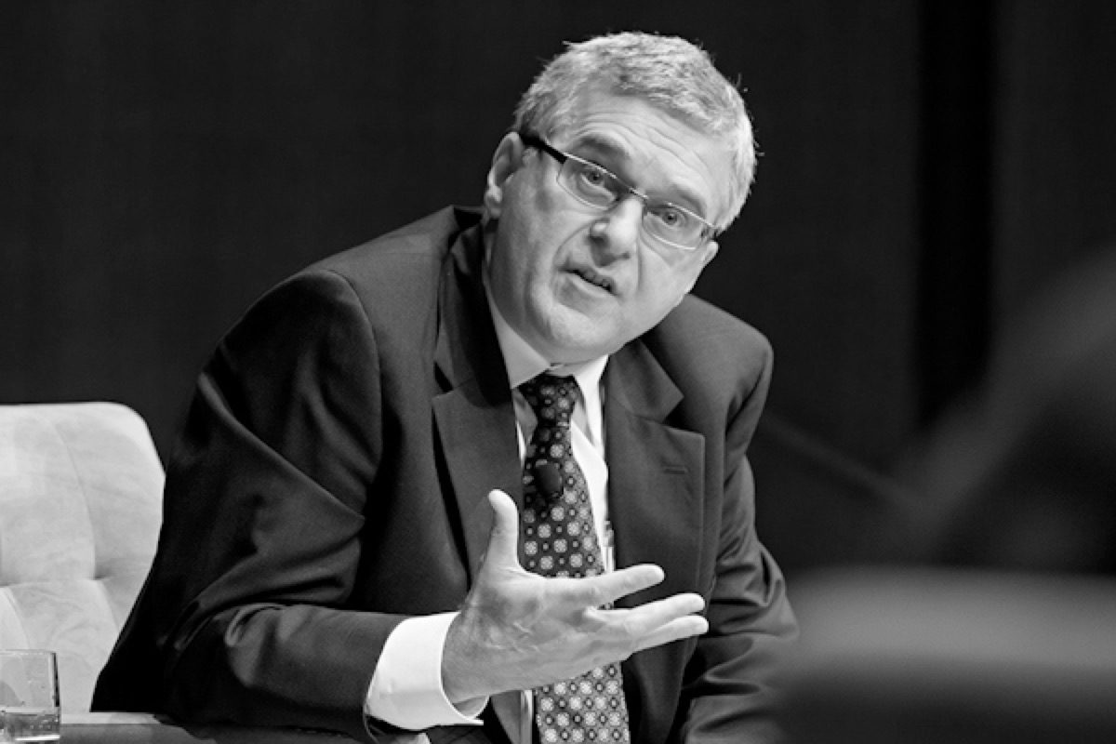
ETHICS
“The study and practice of what constitutes the best regulation of human conduct, individually and socially.”
– Stephen Ward, U. Wisconsin

Slide 3
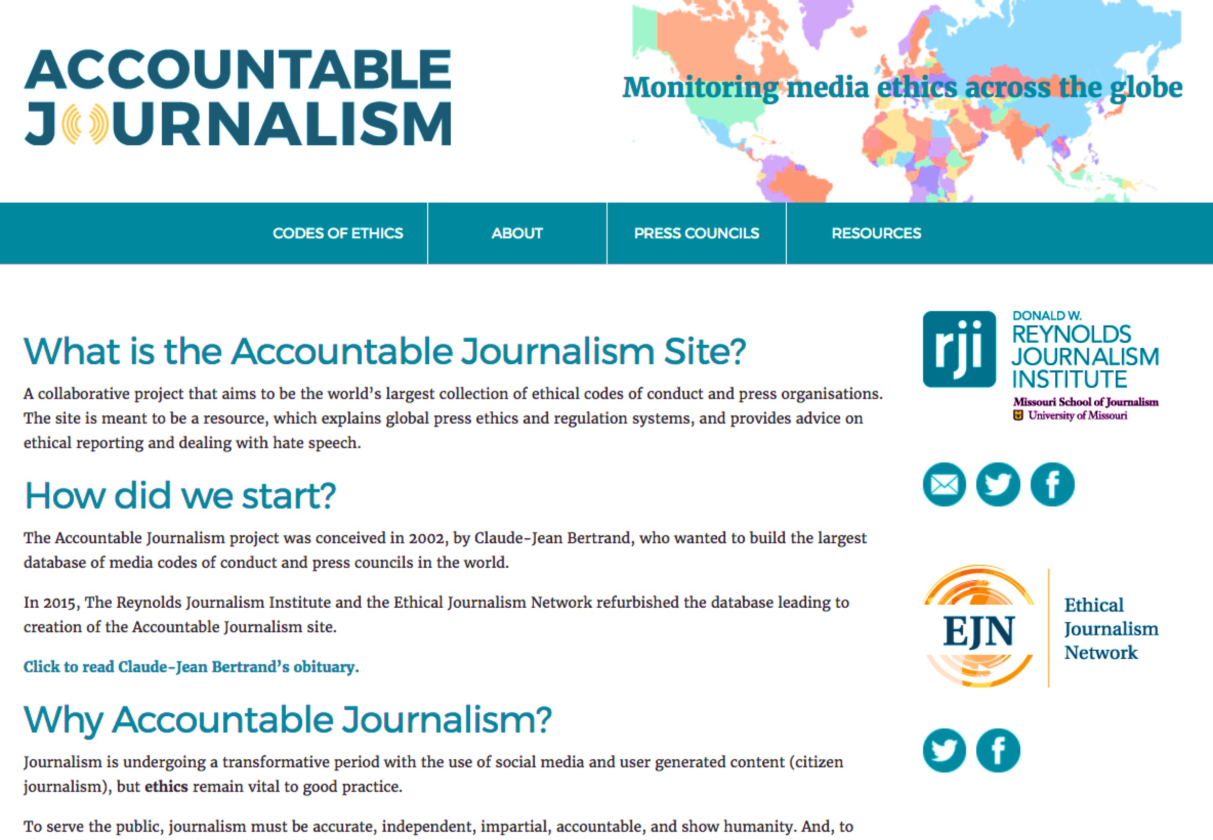
“Journalistic expression is not a free for all, but rather speech which is constrained by ethical values.”
https://accountablejournalism.org/ethics-codes
Notes:
400 + Codes of conduct from around the world – there isn’t really ONE standard … ethics is flavored by local norms, cultures, and expectations for behavior.
Also this database can be helpful for understanding how codes have changed over time.

Slide 4
Codes of Conduct
Society of Professional Journalists (SPJ)
Seek Truth and Report It
Minimize Harm
Act Independently
Be Accountable and Transparent
https://www.spj.org/ethicscode.asp

Slide 5
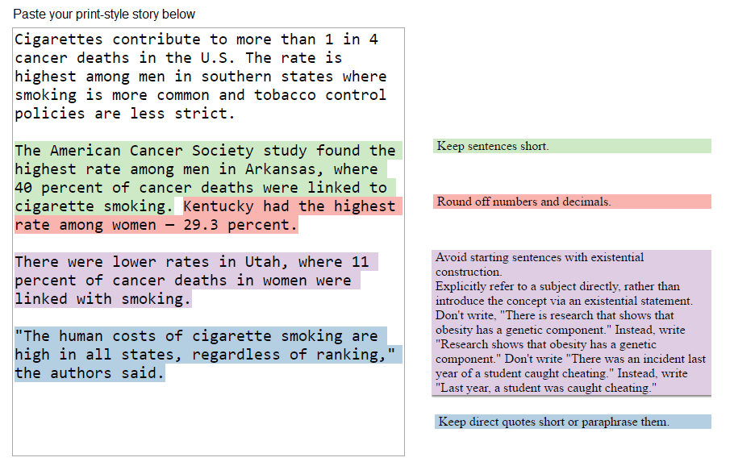
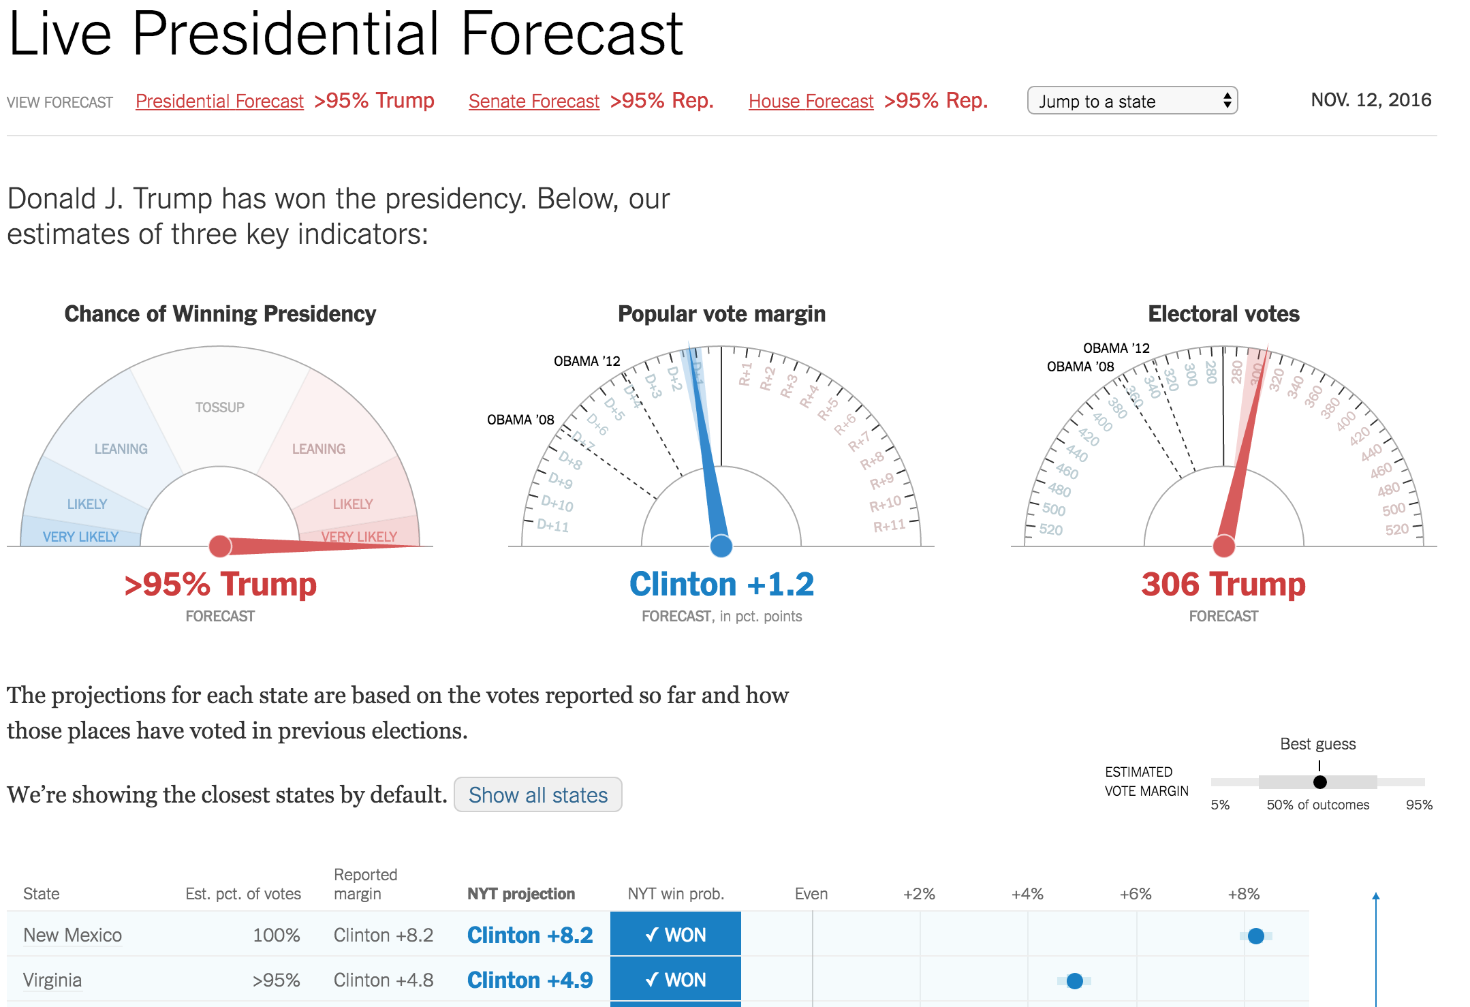
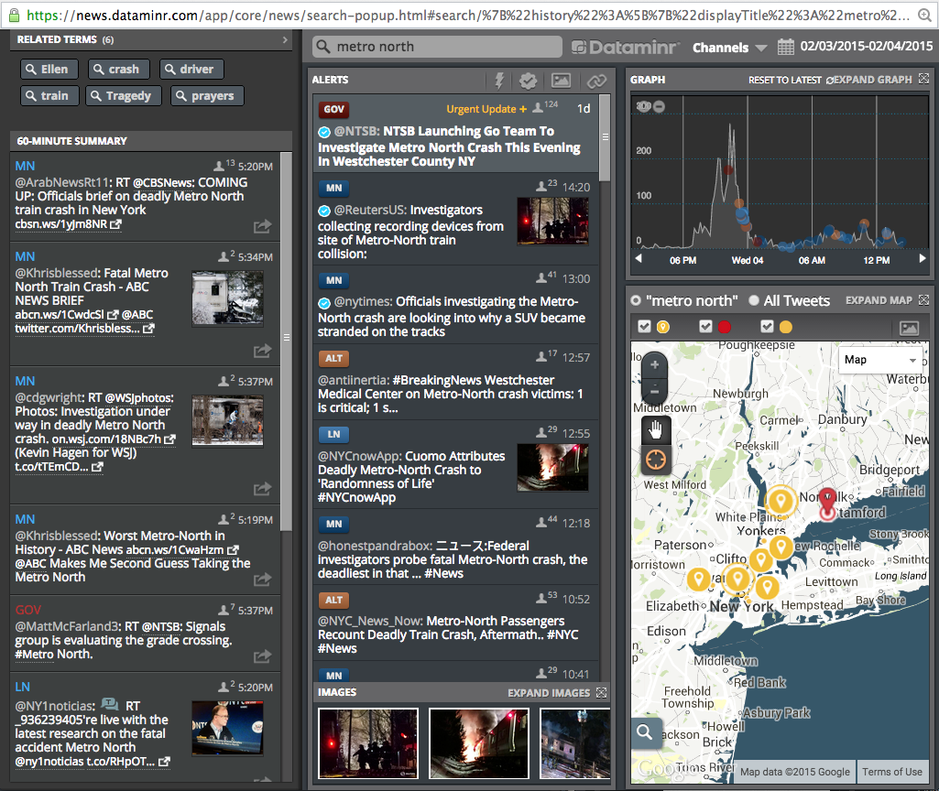
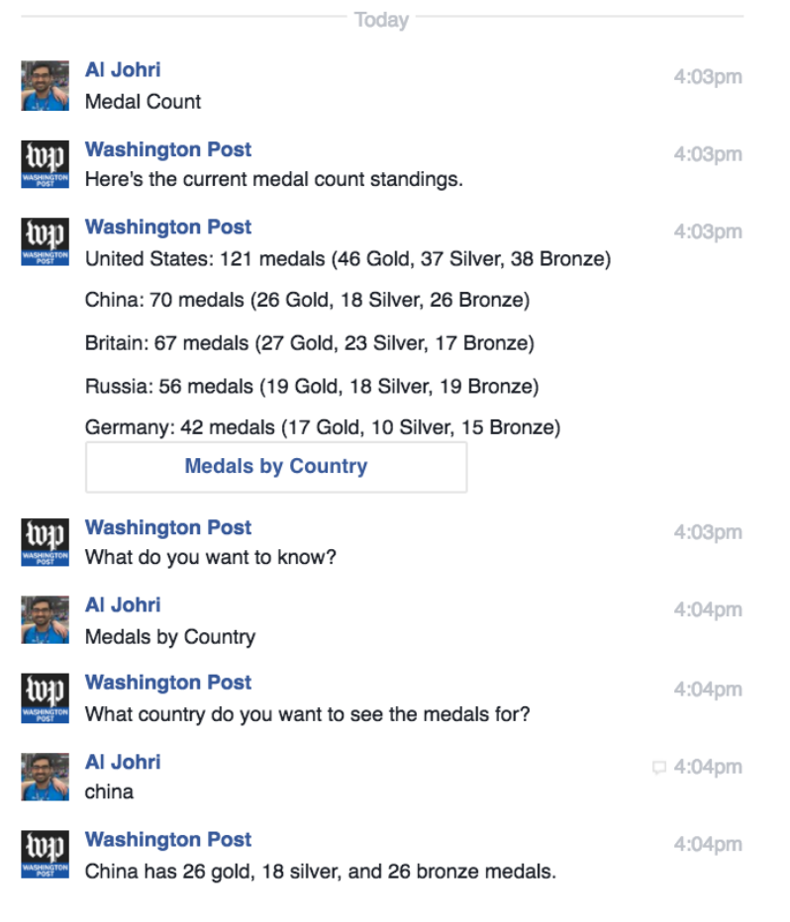
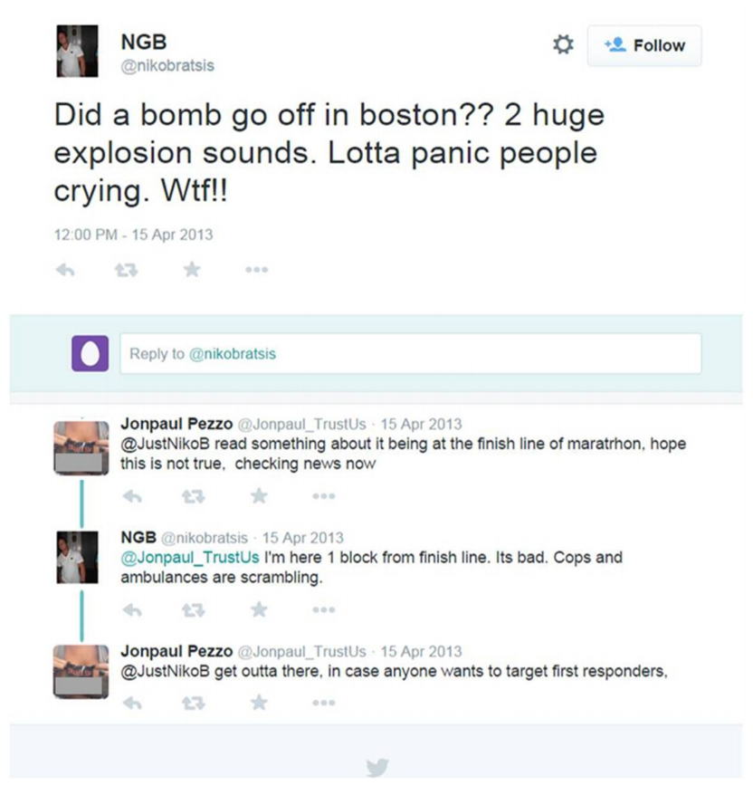
Notes:
So how do we apply such codes of conduct to new forms of computational and data journalism, or to algorithmic media more broadly

Slide 6
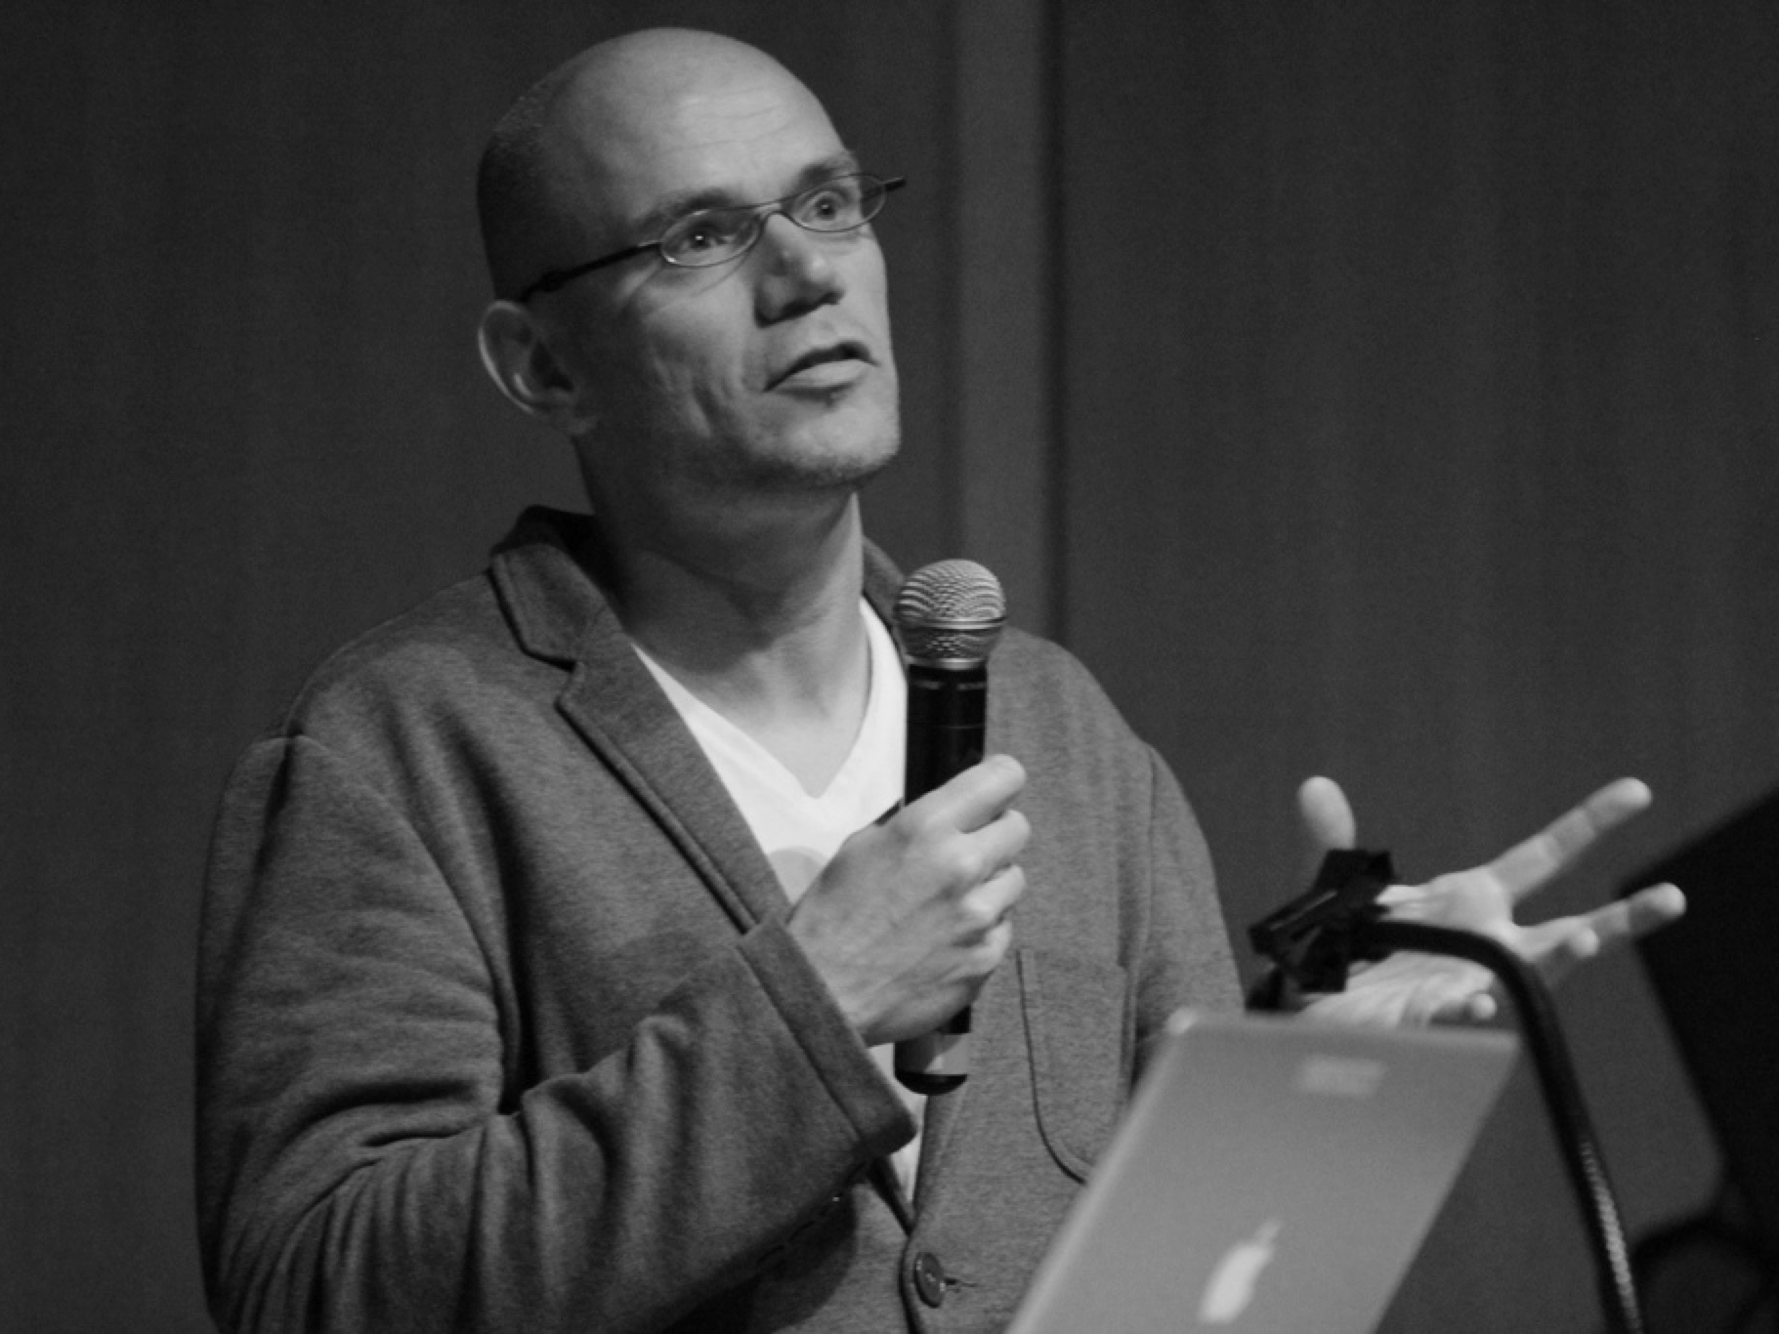
TRANSPARENCY
Transparency is defined as “the ways in which people both inside and external to journalism are given a chance to monitor, check, criticize and even intervene in the journalistic process.”
– Mark Deuze, University of Amsterdam
Notes:
Transparency is one route to media accountability, of course there are others like a healthy critical media, institutional pressure and norm setting, sanctioning in some cases (like press councils)

Slide 7

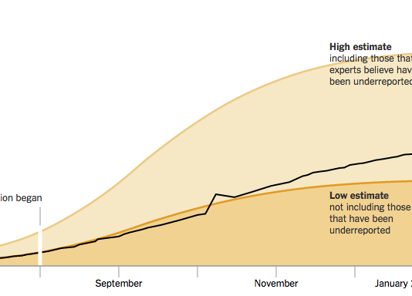
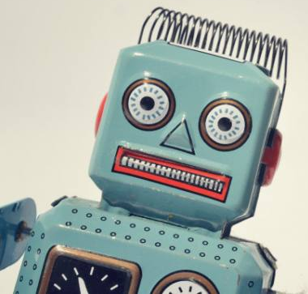
Algorithmic Transparency
Automated News Content
Algorithmic Curation
Simulation & Modeling
What could be made public about the algorithm?
What are limits of algorithmic transparency?
What are comprehensive disclosure mechanisms?
Notes:
In human computer interaction a variety of studies have examined the role of information disclosure and explanation around specific algorithms such as recommender systems, personalization, or grading.
This is an example of what I’m calling algortihmic transparncy. We’re working on developing a model that can be useful in diff situations, particularly in the media.
Convened about 50 people at Tow Center to talk through case studies and examine what we might make transparent. Transcribed all sessions and analyzed qualitatively. Hope to have a paper out about that study soon!

Slide 8
Human Involvement
Data
Model
Inference
Interface
I/O
Pipeline
Notes:
Towards an algo transparency model.
A chance to advance the deontological ethics of algorithms by suggesting standards for what might be disclosed.
There were broadly 5 areas that people felt would be interesting to have more transparency. There are specifics to each of these and we hope to further develop to apply the standard to specific cases to demonstrate its use.
The role of humans in these processes was something that came up over and over.
Also to note is that the set of dislosable information

Slide 9
Towards a Transparency Standard
1. Human Involvement
Goal / purpose / intent? Who has oversight? Who are authors?
If third party, how configured / parameterized?
The “Algorithmic Presence”: whether an algorithmic process was being employed at all. Personalization? A/B testing?
“What is the baseline here and what are we expecting of algorithms that we don’t expect of human writers?”
Notes:
Can we ever really disentangle the roles and decision of humans versus algorithms in specific algorithmic systems?

Slide 10
Towards a Transparency Standard
2. Data
What’s input to the system?
Data quality (accuracy, completeness, uncertainty, timeliness); sampling method; variable definitions; provenance (sources, public or private); volume of training data; assumptions in collection; inclusion of personally identifiable information
“You want to see the data profile that they’re using on you that the algorithm is reacting to.”

Slide 11
Towards a Transparency Standard
3. Model
Input scheme: variables / features; target variables for optimization; feature weightings; name or type of model; software modeling tools; source code or pseudo-code; thresholds or embedded rules
Differences in “editorial” human choices affecting model, and implementation decisions

Slide 12
Towards a Transparency Standard
4. Inference
Classifications, numerical predictions
Existence of inferences at all; accuracy of classifications and predictions (FP, FN rates); benchmarks to standard datasets; Error / failure analysis; Uncertainty and confidence values
“The algorithms is making assumptions about who you’re closest to or what content you want to see and those inferences may not be completely accurate.”

Slide 13
Towards a Transparency Standard
5. Interface
Face presented to end-user
Algorithmic presence; on / off indicator; tweakability of inputs or weights and comparability of outputs
Directly integrate transparency info in UI? Transparency reports?
“…the thing that I struggle with is coming up with a way to not add to the overload hwen we’re helping people understand.”
Notes:
One promising path forward is to align information disclosures in a way that enhance the user experience.
But other forms of transparency information are less relevant to the immediate UX and more for broader public: censorship, bias in attention.

Slide 14

BUSINESS CONCERNS
Costs of information production (data prep, documentation, benchmarking)
Privacy issues
Legal concerns over admitting errors / uncertainties
Trade secrets & competitive advantage
Manipulation & gaming
Notes:
There were of course many business concerns. The viability of the algo transparency with commercial entities hinges on these and thus they’re all viable applied research opportunities.
Cc https://www.flickr.com/photos/jlcernadas/8986321322

Slide 15
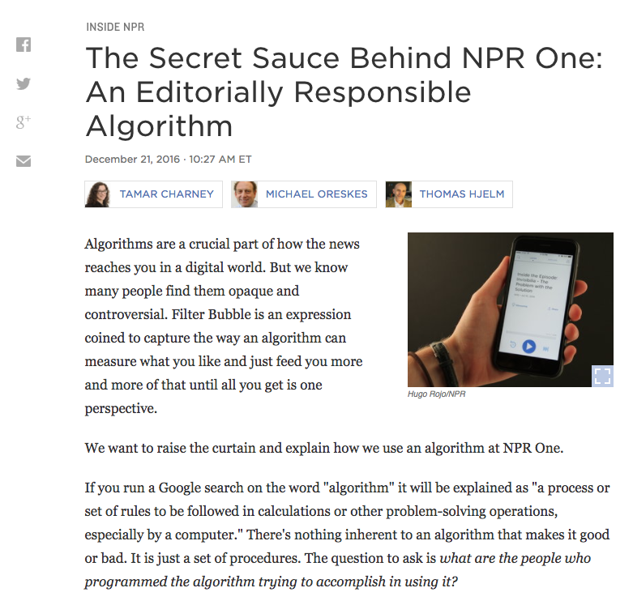
Notes:
Yes these concerns aren’t slowing down some organizations who are trying to be forthcoming about how, in this case, personalization is functioning.

Slide 16
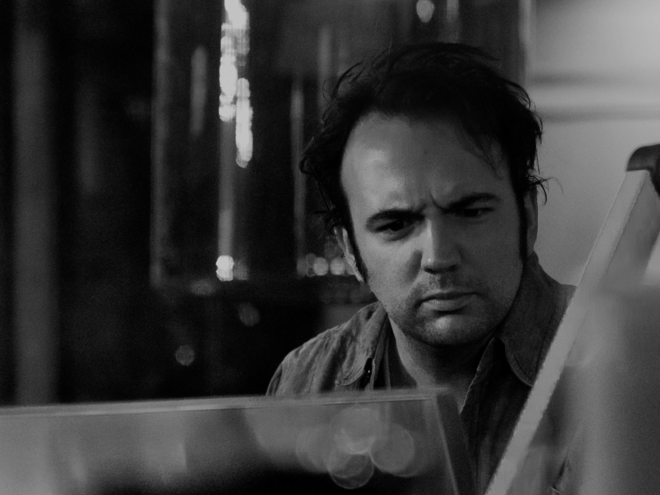
COGNITIVE COMPLEXITY
Transparency information needs to be accessible and understandable
What’s the right vehicle for this information?
“If it’s detailed enough for somebody to understand the science of algorithms to really use critically, maybe 1 percent of the readership would be able to use it.”
Notes:
https://www.flickr.com/photos/maartmeester/5299868320/
There were of course many business concerns. The viability of the algo transparency with commercial entities hinges on these and thus they’re all viable applied research opportunities.
We’re currently purusing a project to better understand whether there can be meaningful disclosure that maintains trust without hurting the user experience. In our lab, in collaboration with IEEE, and in another collaboration with U. Munich.

Slide 17
Readings
Algorithmic Transparency in the News Media
What do you think are the risks / rewards of algorithmic transparency?
To what extent do you think cost should factor into whether a newsroom makes a piece of computational or data journalism transparent?
Should NPRs apps be held to the same standard of transparency as it’s data stories? Why or why not?

Slide 18
Readings
Peer Reviewing our Data Stories
As an ethical question, why might data journalists want to engage or not engage in peer review of their work?
What might peer review even look like for data journalism?
Notes:
Vetting of analysis prior to publication vs. posting data and methods along with story.
“If the entire story hinges on conclusions that you found through an analysis, then it’s worth comparing notes with someone else.”
Possible methods: circulate white paper, show to colleague,

Slide 19
Analytics: Measuring “Impact”
What does it mean for journalism to have impact?
Reach
Engagement
Persuasion
Change & Reform
Can we measure these quantitatively?
What affects the impact metrics we use?
Notes:
Profit motive creates pressure for scale that can drive as many ad impressions as possible (ads are sold based on number of impressions, or number of clicks on the ads).

Slide 20
Readings
The Ethics of Web Analytics
Do you think journalists / reporters should have access to content analytics? Should those analytics have a role in editorial processes?
How should journalists use web analytics so that we don’t all end up reading celebrity gossip, or looking at cat memes?
Why do Tandoc and Thomas argue that segmenting the audience is not a good thing?
Notes:
Need to distinguish “public interest” with “what the public is interested in” – but how does for-profit media problematize that? What’s wrong with just giving people what they want in terms of content?
Segmenting the audience is in tension with pursuing the common good, and in creating common ground. But how to avoid the race towards lowest common denominator that is needed for scale in advertising? Click based logic of scale marginalizes smaller interest groups e.g. those interested in public affairs

Slide 21


Slide 22
An Ethical Newsfeed?
Groups of three
Consider the SPJ Code of Ethics (handout)
Premise: that Facebook newsfeed might be treated according to journalistic standards
Consider if one or more of the codes in SPJ guide are applicable to the newsfeed.
Does the code need to be adapted in any ways to be applicable? How would it be applied? What’s not applicable?
How might you redesign the algorithm or interface of the newsfeed to better adhere to that / those code(s)?
Present your ideas back to class

